Slide 1
Management Information System Application (MIS)
System development project

Slide 2


AGENDA
INTRODUCTION
Project goals
Project team
Technical approach & requirements
Design & diagrams
implementation
TIMELINE
conclusion

Slide 3

INTRO
Management Information System App (MIS) is a software application that helps organizations manage their data and information resources effectively.
Here, we have taken an example of Library System Management, which will streamline the management of library operations for Librarian, Students and Suppliers.
Users can easily search for and locate library resources, borrow and return books, and manage their accounts through an intuitive and user-friendly interface.

Slide 4
Project goals
Library system management

Slide 5
Primary goals
To develop a software application using JAVA programming language and object-oriented design principles for managing library operations.
To create various diagrams such as UML, State diagram, Sequence diagram, etc. to help visualize the system architecture and design.
To incorporate SQLite as Database technologies, specifically to store and manage library data efficiently.
To implement user authentication and authorization using user id and password, ensuring secure access to library resources.
To include validation features to ensure data integrity and minimize errors in the system.
To maintain version control of the code using Git and provide basic documentation in the form of a README file.
To test the system thoroughly using unit tests and ensure it works within the defined time and space complexity constraints.
To create a system that can support a minimum of 15 users for the trial phase.

Slide 6



Meet our project team
José Roberto Benitez Del Pilar
Kavya Janak Katariya
Nicholas Montecalvo
Developer 1
Developer 2
Developer 3

Slide 7
Technical approach
Project Requirements
Front End : Java, Jframes, swing controls, Unit testing with JUnit
Backend Database: Sqlite
Used concepts of Object oriented programming, SQL commands to run the queries, and Agile Methodology, Singleton class, MVC architecture
Use of Jira for Project Management
Use of Git for version control
System analysis
Environment Development
User interface design
Business logic implementation
Database integration
User authentication and validation
Testing and debugging
Version control and documentation

Slide 8
Design And diagrams
1. UML Diagram
State Machine
Sequence Diagram

Slide 9
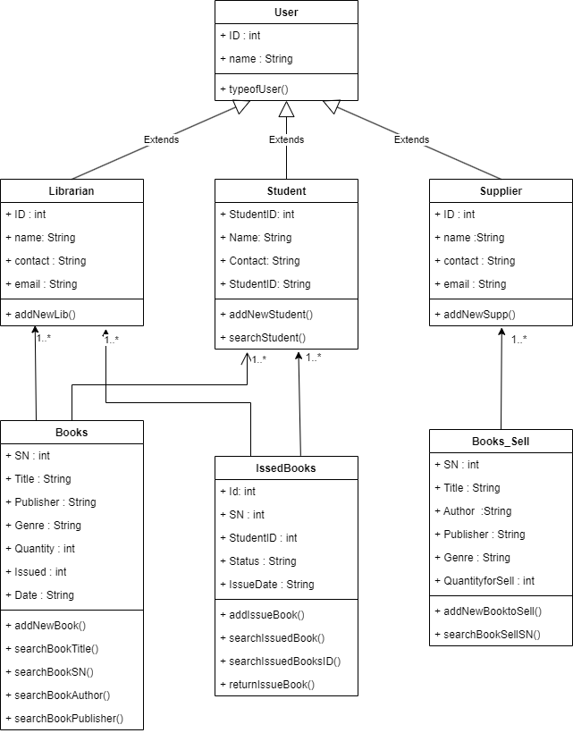
UML Diagram

Slide 10
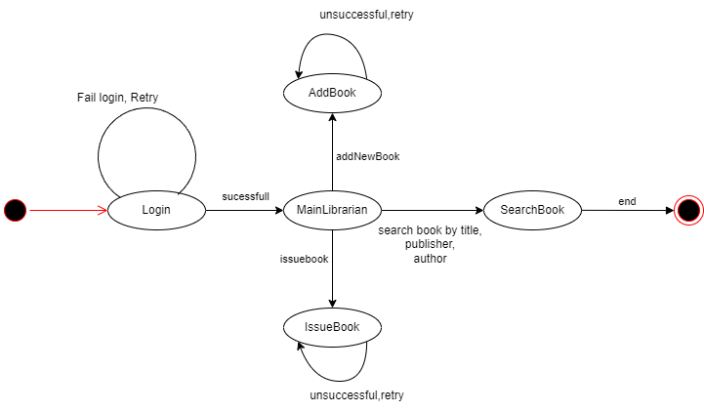
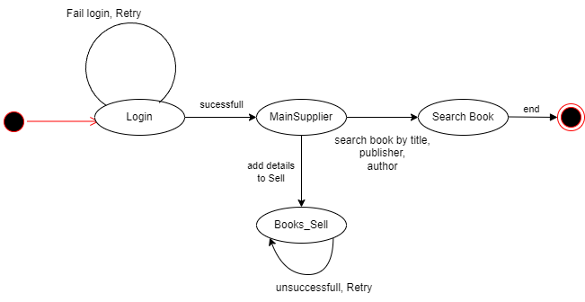
State Diagram
User: Librarian
State Diagram
User: Supplier

Slide 11
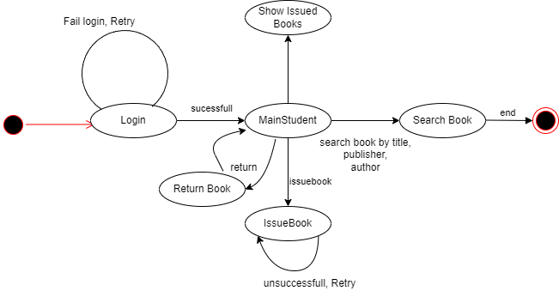
State Diagram
User: Student

Slide 12
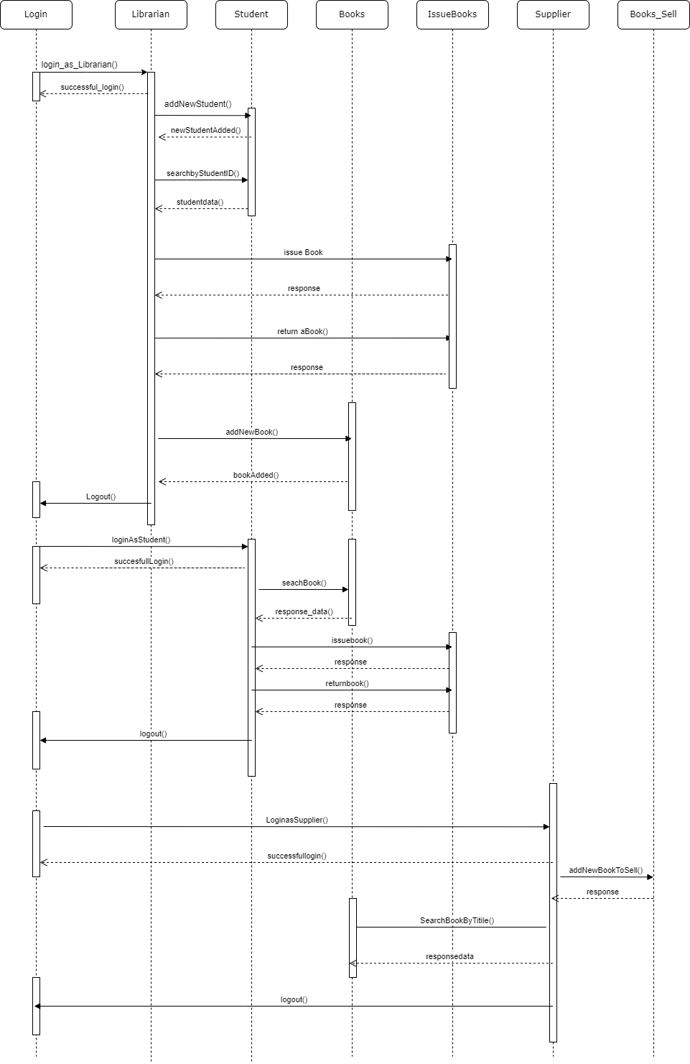
Sequence Diagram

Slide 13
TIMELINE
SPRINT 1 | User login functionality Design and implementation of basic UML and state machine diagrams
SPRINT 2 | Library staff user functionality (add, search, modify book information) User member application functionality Basic documentation in a README file
SPRINT 3 | User functionality (search for a book, borrow a book, return a book) Supplier functionality (search for a book, sell a book) Implementation of Database in SQLite.
SPRINT 4 | Advanced input validation and error handling Additional testing and debugging
FIN | Final Date of Submission

Slide 14




implementation
Login Page
Main Librarian
Main Student
Main Supplier

Slide 15
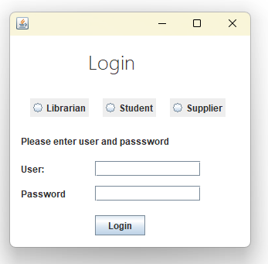

Slide 16
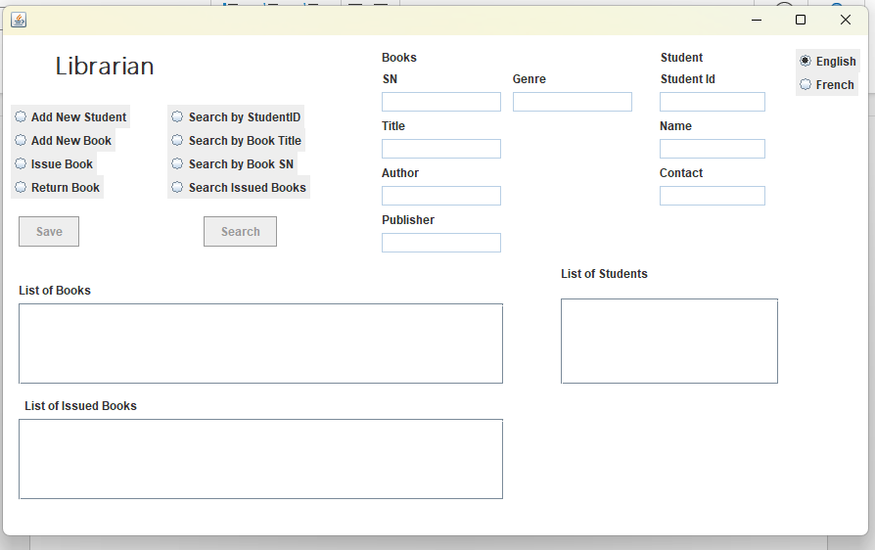

Slide 17
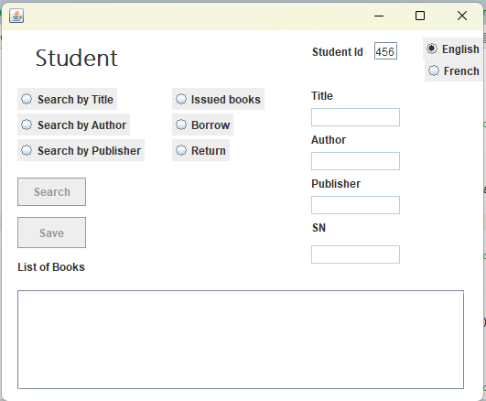

Slide 18
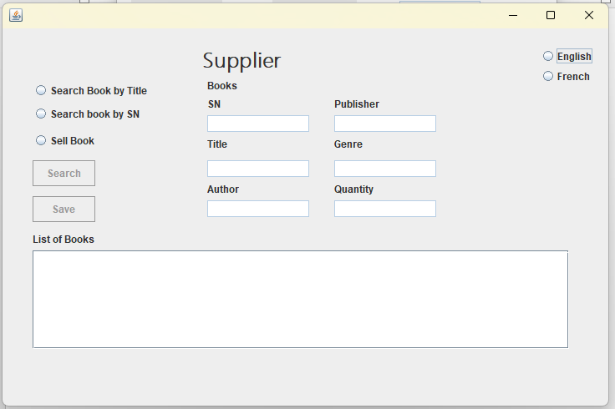

Slide 19

SUMMARY
To expand this project further, we require additional user scenarios. Additionally, we plan to incorporate other functions such as enabling students to renew their membership, managing library books, feature like location of books in the library, and offering library account management features.

Slide 20

THANK YOU
https://github.com/kkatariya097/SystemDevelopment-Project-MISApp

